Slide 2
TIME CHECK
OFFICIAL AIRSHOW TIME
LOCAL

Slide 3
SAFETY BRIEFING
All Participants Performing Today
FAA Monitors
CFR, SAR, Security
Crew and Air Show Essential Personnel

Slide 4

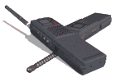


“Please Turn off Cell Phones, Radio’s and Pagers During Briefing”

Slide 5
Introductions
Presenting Sponsor
Airshow Chairman
Vice-Chair
FAA FSDO Monitor
Air Traffic
Airport Director
Fire/Rescue
Ground Coordinator
Sound
Westmark Credit Union
Russel Johnson
Bob Hoff
Diane Hager
Taleesha Hillman
Craig Davis
Shift Cdr
David “Gizmo” Snell
Dave Olmstead CAS

Slide 6
ROLL CALL
Announcer
Rob Reider 8.5
Script - Music

Slide 7
ROLL CALL
Brad Wursten
Julie Clark
Matt Younkin
Todd Therp
John Bagley
Lee Lauderback
Gene Soucy
Will “D-Rail” Andriotta
Adam Vogel
Greg Anders P-51 Heritage
Black Daggars Jumpers
w/Parachutes
Blue Angels
Mig Fury Fighters
Doc-Cujo-Bamboo/Spike

Slide 8

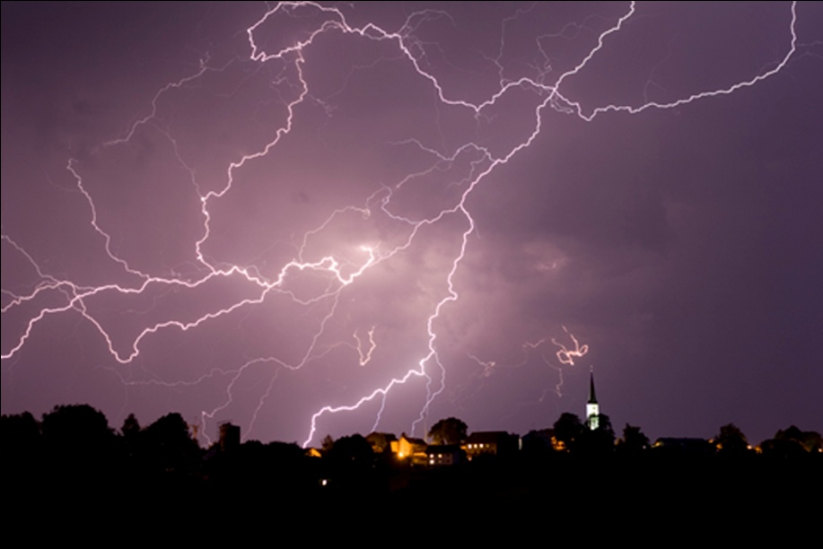
Weather Briefing

Slide 9
WEATHER
METAR:KIDA 211253Z 22008KT 10SM SCT120 09/08 A3014 RMK AO2 SLP165 HZ ALQDS T00890078
TAF: KIDA 211120Z 2112/2212 22008KT P6SM SKC FM211800 23012KT P6SM FEW090 FM220300 20007KT P6SM SKC

Slide 10
Winds Aloft
30
60 290 13
90 290 16
120 240 13

Slide 11
FAA Waiver
91.117 (a) (b)
91.119 (b) (c)
91.121 (a)(1)
91.126 (b) (d)
91.127 (b) (c)
91.129 (c) (e) (f) (g) (i)
91.155
Aircraft speeds 250kts blo 10, 200kts in ….Class D
Minimum Safe altitudes congested area, other than congested
Use of alternate altimiter settings blo FL180
Operations in Class G Airspace(com & turns)
Operations (patterns & Com)in Class E Airspace
Operations in Class D Airspace
Cloud Clearance

Slide 12
FAA Waiver & Authorizations
91.303 (c) (d) (e)
Authorizations……..
105.21
Aerobatic Flight within Class D, on airway, below 1500 ft
Congested Area Parachute Jump

Slide 13
FAA Provisions for Night Demonstration
Night Starts after Civil Twilight
Confined to 1NM either side of Show Ctr
Demo above 500’ and below 5000’
WX minimums 2500 / 3
Twilight ends at 2035 LCL on Friday
Sunset 2102
Along well defined lighted rwy
FAR 91.155 NOT APPLICABLE

Slide 14
Waivered Airspace
1200-1700 Daily S S sfc to FL180
(13000) AGL
TFR
1200 1700 sfc to 13000 AGL (18000 MSL)

Slide 15
FDC 7/1913 ZLC ID..AIRSPACE SALT LAKE CITY, IDAHO FALLS, ID..TEMPORARY FLIGHT RESTRICTION. THIS NOTAM REPLACES NOTAM 7/1216 TO UPDATE THE SHOW TIMES TO EXLCUDE THE NIGHT SHOW ON JULY 22ND (JULY 21ST NIGHT SHOW). . PURSUANT TO 14 CFR SECTION 91.145, MANAGEMENT OF ACFT OPS IN THE VCY OF AERIAL DEMONSTRATIONS AND MAJOR SPORTING EVENTS, ACFT OPS ARE PROHIBITED WI AN AREA DEFINED AS 7NM RADIUS OF 433117N1120458W (IDA265000.8) SFC-17999FT MSL
EFFECTIVE
1707201800 UTC UNTIL 1707202000 UTC, Thu 1200 - 1400
1707202100 UTC UNTIL 1707202230 UTC, Thu 1500 - 1630
1707211800 UTC UNTIL 1707212300 UTC, Fri 1200 - 1700
1707221800 UTC UNTIL 1707222300 UTC, AND Sat 1200 - 1700
1707231800 UTC UNTIL 1707232300 UTC. Sun 1200 - 1700
DUE TO HIGH SPEED AERIAL DEMONSTRATION BY THE USN BLUE ANGELS. UNLESS AUTHORIZED BY ATC. JIM TUCCIARONE, PHONE 216-390-8410, IS THE POINT OF CONTACT. THE IDAHO FALLS ATCT /IDA/ ATCT, PHONE 208-523-7045, IS THE FAA COORDINATION FACILITY. 1707201800-1707232300

Slide 16
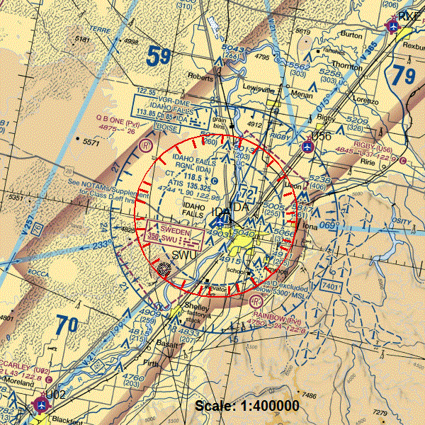
TFR DAYTIME

Slide 17
FDC 7/1911 ZLC ID..AIRSPACE SALT LAKE, IDAHO FALLS, ID..TEMPORARY FLIGHT RESTRICTION. PURSUANT TO 14 CFR SECTION 91.145, MANAGEMENT OF ACFT OPS IN THE VCY OF AERIAL DEMONSTRATIONS AND MAJOR SPORTING EVENTS, ACFT OPS ARE PROHIBITED WI AN AREA DEFINED AS 7NM RADIUS OF 433117N1120458W (IDA265000.8) SFC-17999FT MSL
EFFECTIVE 1707220330 UTC UNTIL 1707220430 UTC. 2130 - 2230
DUE TO HIGH SPEED AERIAL DEMONSTRATION BY THE USN BLUE ANGELS. UNLESS AUTHORIZED BY ATC. JIM TUCCIARONE, PHONE 216-390-8410, IS THE POINT OF CONTACT. THE SALT LAKE CITY /ZLC/ ARTCC, PHONE 801-320-2561, IS THE FAA COORDINATION FACILITY. 1707220330-1707220430

Slide 18
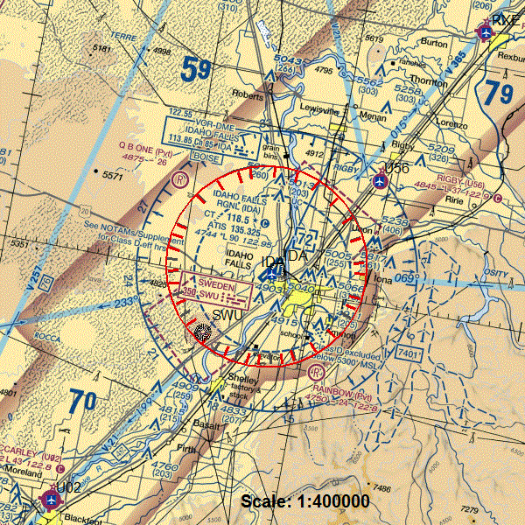
TFR Night

Slide 19
The following aircraft attitudes will be considered Aerobatic Flight:
For all solo aircraft: when the pitch angle exceeds a positive or negative 60° angle from the horizon, and/or when the bank angle exceeds 75°.
b. For formation flights: when the pitch angle exceeds a positive or negative 45° angle from the horizon, and/or when the bank diverges from level flight in excess of 60° .

Slide 20
AIR SHOW RUNWAY
Rwy 2/20 9002 x 150
Elevation 4744’
Magnetic Variation 15E
Tower Open 0700 - 2000

Slide 21
AEROBATIC BOX see chart
Crowd Line
Cat III Line 500
Cat II Line 1200
CAT I (1500)
Red Line (Orange) Plastic Snow Fencing
Outboard Edge of RWY 2-20
556 ft
West of road at 1140’ Parallel to RWY
5000’ x 50’ White Tarp
1500 ft

Slide 22
AEROBATIC BOX
Show Center Cat I
Show Center Cat III
Crowd left Corner
Crowd Right Corner
Large White Tractor Trailer
GS Antenna – Stub @ PAPI -VOR
White Plastic in front of Terminal Pass SOUTH of Term Ramp
White Plastic North of Rwy 17 appch

Slide 23
Aerobatic Boxes

Slide 24
Aerobatic Dimensions Blue Angels
Center + White Tractor Trailer + ARFF

Slide 25
Aerobatic Box CAT III GREEN
Show Center – Corner Markers

Slide 27
Night Show Box & Center

Slide 28
Air Methods Life Helicopter

Slide 29
Interstate Closed….River Closed
Controlled Bail-out Area

Slide 30
OBSTRUCTIONS
Antenna Across from “C”
Glide Slope Antenna
Wind Sock x 2 West
Height ~ 20 ft
Height 29ft
About 10 ft

Slide 31
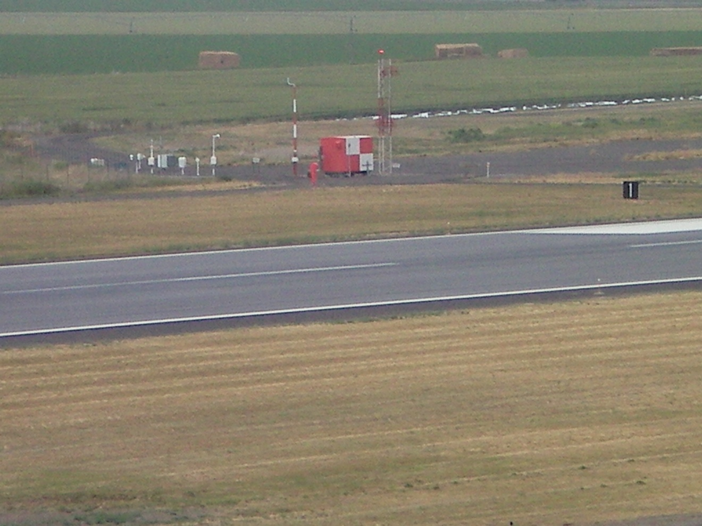
Obstruction GS Antenna/ASOS
29 Ft

Slide 32
PIT AREA
Be at Aircraft Two (2) Acts Before Start
Use Marshallers for Startup, Wing Walkers, Parking
Plan Taxi Routes Taxiway
Essential Crew Only
PIT MANAGER “Gizmo’s Folks”

Slide 33
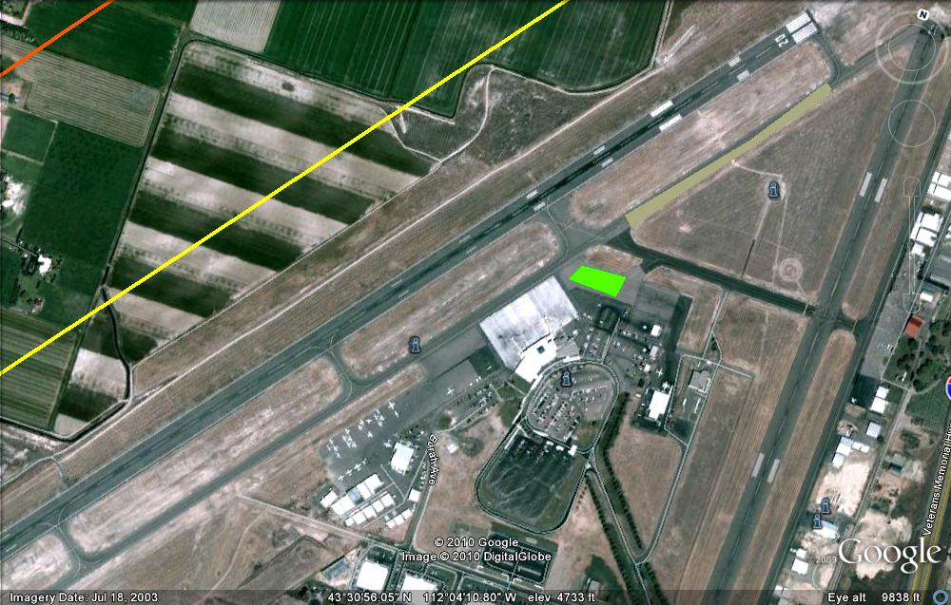
Taxi Routes

Slide 34
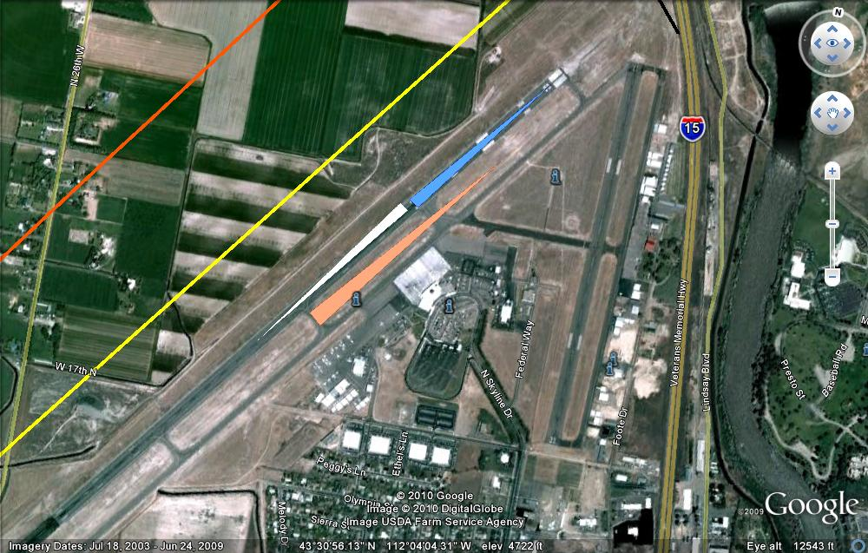
Runway Intersections
Blue 2 @ C = 1800
White 20 @ C = 7200
Salmon 2 @ A2 = 3600

Slide 35

Caution Parachutist
NO vehicular traffic near the jump area (PLA)
NO props turning within 1,000 feet of the jump area (PLA)
If you are the act following the jump team, call the AirBoss prior to starting your engine
Ask if you are not sure…

Slide 36
Fuel and Smoke Oil
Truck in Staging Area
Please advise of any Special Needs

Slide 37
A FEW RULES
NO AIRCRAFT WILL BE TAXIED THROUGH A CROWD AREA.
NO AIRCRAFT WILL BE STARTED IN A CROWD AREA. (THIS INCLUDES THE STATIC DISPLAY AREAS.)
NO AIRCRAFT WILL BE FUELED IN A CROWD AREA OR THE STATIC AREAS.

Slide 38
FREQUENCIES
Air Boss Primary VHF 125.025
Back-Up VHF 118.5
Tower Frequencies VHF/UHF 118.5 / 257.8
Unicom Frequency 122.95
ASOS 135.325
              Phone 208-524-4553
Discrete Frequencies VHF 127.875
Stuck Mike - Check

Slide 39
Zero Altimeters
Actual field elevation 4744’
Magnetic Var = 15E
CHECK DENSITY ALTITUDE

Slide 40
Arresting Gear
An arresting Gear has been temporarily Installed on Runway 17/35 at Pocatello Contact ZSL on 128.35
Location: 212 hdg at 49NM
Status: Armed

Slide 41
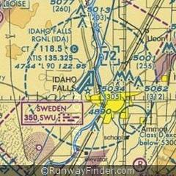
Life Guard Helicopter & Fixed Wing
Level II Trauma Center

Slide 42
Emergencies
Fly your aircraft first and then advise the AirBoss of you condition
If you are on the discrete frequency, STAY
If you see a vehicle with flashing lights in the center of the runway, DIVERT, you will be given alternate instructions on the primary AirBoss/Tower frequency
The Divert/Holding area is located behind the crowd on the downwind (Where River and Interstate are Closest) @1,000 AGL Also Perch
In the case of an emergency, the Airport will be released to the “Airport Authority” who will assume the operations and implement the “Airport Emergency Plan”
Please refer all questions to the appropriate officials of the Air Show.

Slide 43
EMERGENCIES
Please advise the Emergency Personnel of any Special instructions about your aircraft
  Where is the best place to lift your aircraft
  Where are the Best entry points in case of an accident
  Discuss any Special needs of your aircraft with the emergency personnel
Share your Knowledge, it may be your lifeline…

Slide 44
Distribute Schedules

Slide 45
Inclement Weather
Ceiling and Visibility Not less than 1500/3
Call of the Air Boss / FAA Monitor
ALWAYS - At the Discretion of the Pilot in Command

Slide 46
SCHEDULE SATURDAY

Slide 47
SCHEDULE
NOTE: Air Carriers WILL NOT be operating During the Waivered Times
Sunday One arrival at show conclusion

Slide 48
REVIEW
Frequencies
125.025 Airboss
118.5 Twr / Bkup
127.875 Discreet
257.8 UHF
121.7 IDA Ground
Sign Waiver
Meet with Announcer
Maintain Physical Condition
Air Carrier Operations
Density Altitude

Slide 49
SAFETY FIRST
Drink Plenty of Water
Advise of any Needs
Take time for yourself
If you are not comfortable…say so
CHECK DENSITY ALTITUDE
USE YOUR PRACTICE DAY

Slide 50
PHOKUS

Slide 51
“Please Turn off Cell Phones, Radio’s and Pagers During Briefing”

Slide 52
BRIEFING
Saftey Briefing Tomorrow
HERE
9:00 am

